Slide 1
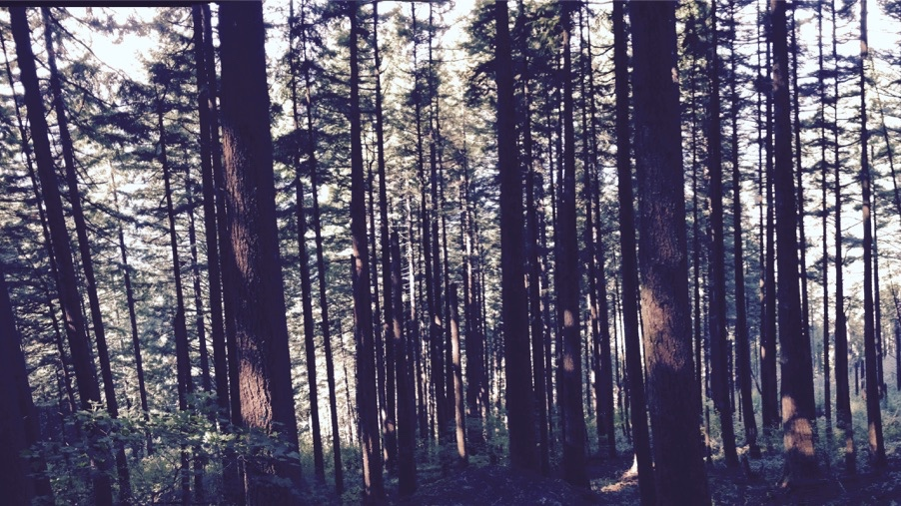
Simulating photosynthetic acclimation using least-cost optimality
Nick Smith & Helen Scott
Department of Biological Sciences
Texas Tech University

Slide 2
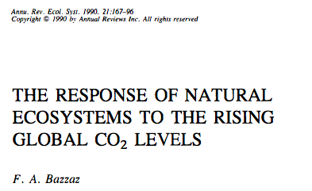
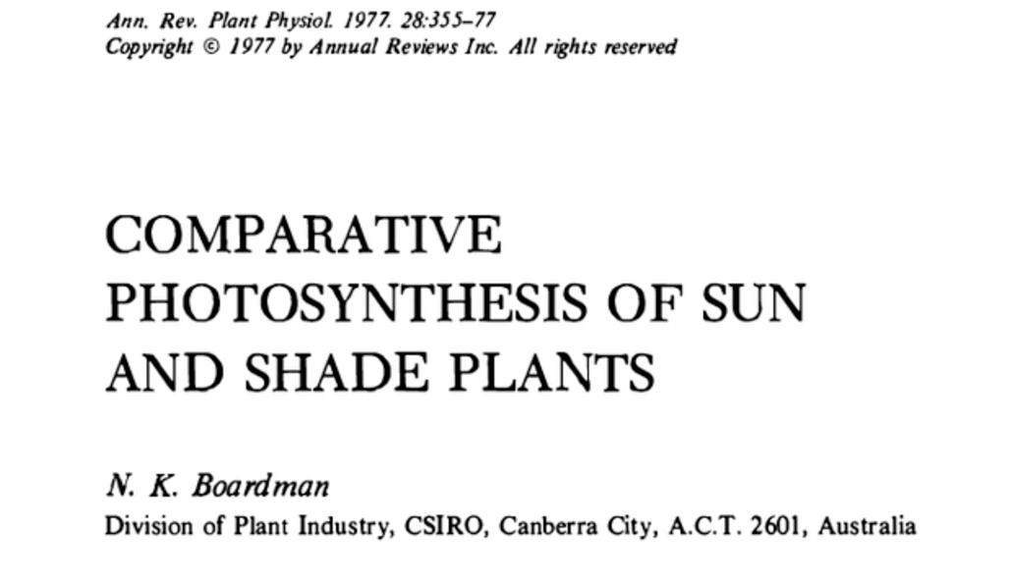
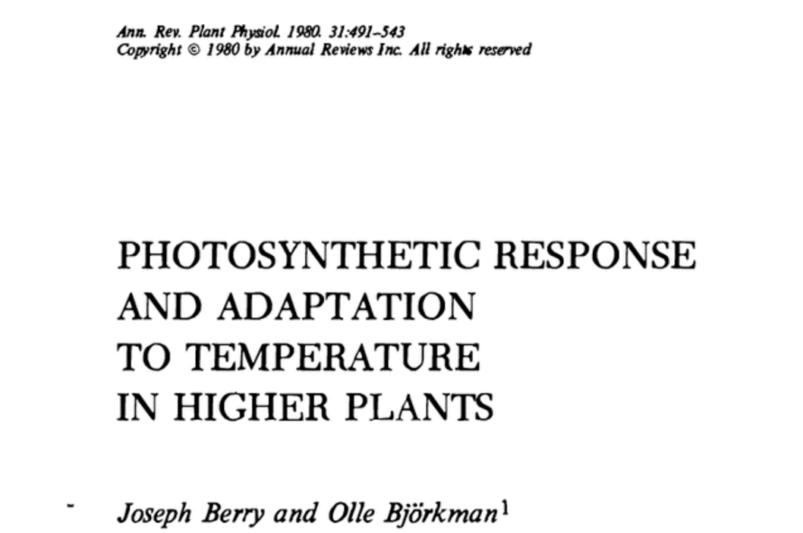
Photosynthetic acclimation is ubiquitous and well known…
nick.smith@ttu.edu
Temperature: Berry & Björkman (1980)
CO₂: Bazzaz (1990)
Light: Boardman (1977)

Slide 3
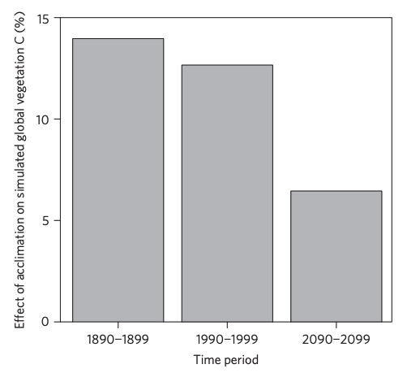
…and can possibly impact carbon cycling and climate
nick.smith@ttu.edu
Acclimation increase future C storage by ~6%
Acclimation alters future temperature by >1°C
Smith et al. (2017) Nature Climate Change
Smith et al. (2017) JAMES

Slide 4
Here’s the problem: No theoretical model for photosynthetic acclimation exists
nick.smith@ttu.edu

Slide 5
So, we developed a mechanistic model of photosynthetic acclimation Based on least cost optimization and the first principles of plant physiological theory
nick.smith@ttu.edu

Slide 6
Least cost theory
nick.smith@ttu.edu
Maintain fastest rate of photosynthesis at the lowest cost (water and nutrient use)
Wright et al. (2003) American Naturalist

Slide 7
Optimal photosynthesis
nick.smith@ttu.edu
Photosynthesis = f{stomatal conductance,
photosynthetic biochemistry}

Slide 8
Optimal photosynthesis
nick.smith@ttu.edu
Photosynthesis = f{stomatal conductance,
photosynthetic biochemistry}
Must predict optimal rates of both

Slide 9
Optimal photosynthesis
nick.smith@ttu.edu
Photosynthesis = f{stomatal conductance,
photosynthetic biochemistry}

Slide 10
Optimal photosynthesis
nick.smith@ttu.edu
Photosynthesis = f{stomatal conductance,
photosynthetic biochemistry}
OTPIMAL CONDUCTANCE IS NOW INCLUDED IN MANY MODELS
e.g., Prentice et al. (2014), Medlyn et al. (2011)

Slide 11
Optimal photosynthesis
nick.smith@ttu.edu
Photosynthesis = f{stomatal conductance,
photosynthetic biochemistry}

Slide 12
Biochemistry optimization: Coordination hypothesis
nick.smith@ttu.edu
Optimal setup = equal limitation by all factors

Slide 13
Optimally: electron transport-limited (A_{j}) = Rubisco-limited (A_{c})
nick.smith@ttu.edu
A_{j} = A_{c}
Smith et al. (2019)

Slide 14
Optimally: electron transport-limited (A_{j}) = Rubisco-limited (A_{c})
nick.smith@ttu.edu
A_{j} = A_{c}
A_{j} = f{J_{max}, light, T, CO₂}
A_{c} = f{V_{cmax}, T, CO₂}
Smith et al. (2019)

Slide 15
Optimally (C₄): A_{j} = Rubisco-limited A_{c} = PEP-limited (A_{p})
nick.smith@ttu.edu
A_{j} = A_{c} = A_{p}
A_{j} = f{J_{max}, light, T, CO₂}
A_{c} = f{V_{cmax}, T, CO₂}
A_{p} = f{V_{pmax}, T, CO₂}
Smith et al. (2019)

Slide 16
nick.smith@ttu.edu
Can rearrange the formulas to solve for acclimated traits
V_{cmax}
J_{max}
V_{pmax}
Smith et al. (2019)

Slide 17
nick.smith@ttu.edu
V_{cmax}
J_{max}
V_{pmax}
= f{average env. conditions}
Smith et al. (2019)

Slide 18
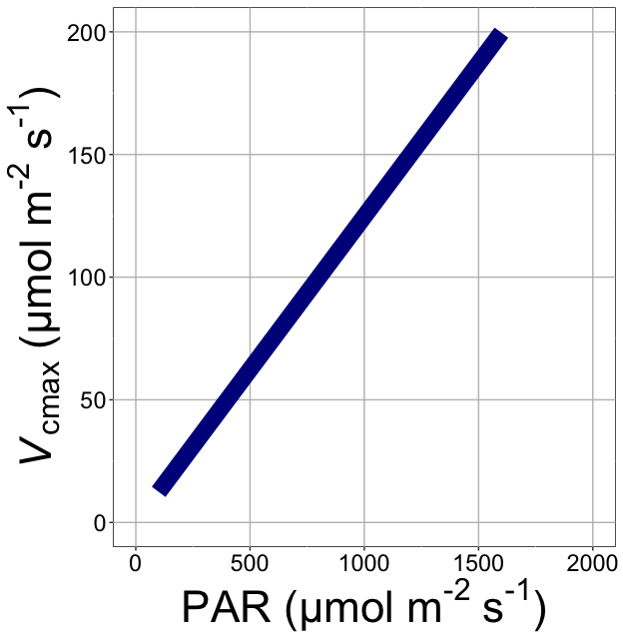
nick.smith@ttu.edu
V_{cmax} increases with light because of greater electron transport
Smith et al. (2019)

Slide 19
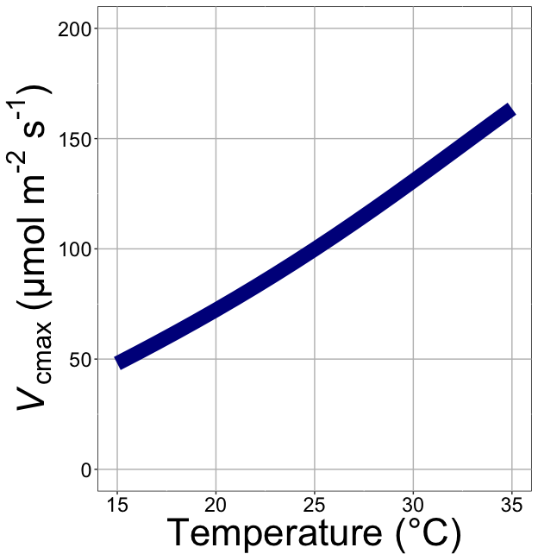
nick.smith@ttu.edu
V_{cmax} increases with temperature because of greater electron transport and photorespiration
Smith et al. (2019)

Slide 20
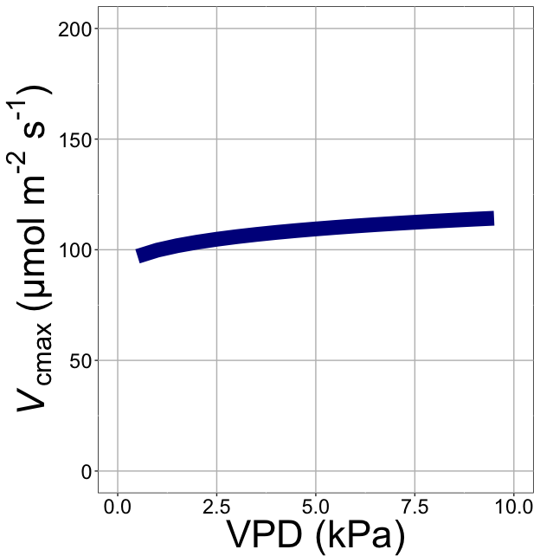
nick.smith@ttu.edu
V_{cmax} increases with VPD because of lower stomatal conductance
Smith et al. (2019)

Slide 21
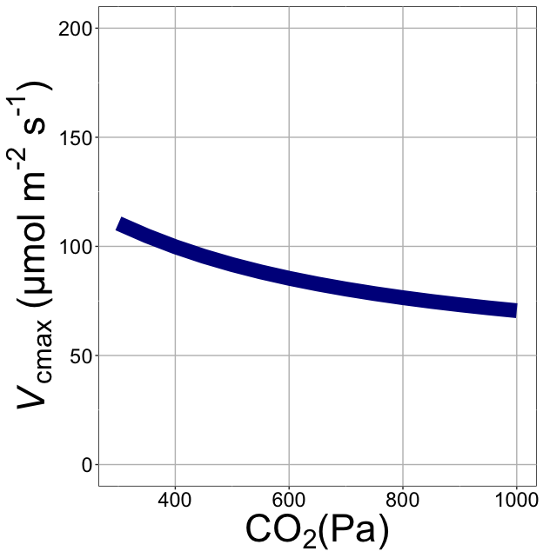
nick.smith@ttu.edu
V_{cmax} decreases with CO₂ because of greater CO₂ in the leaf
(ppm)
Smith et al. (2019)

Slide 22
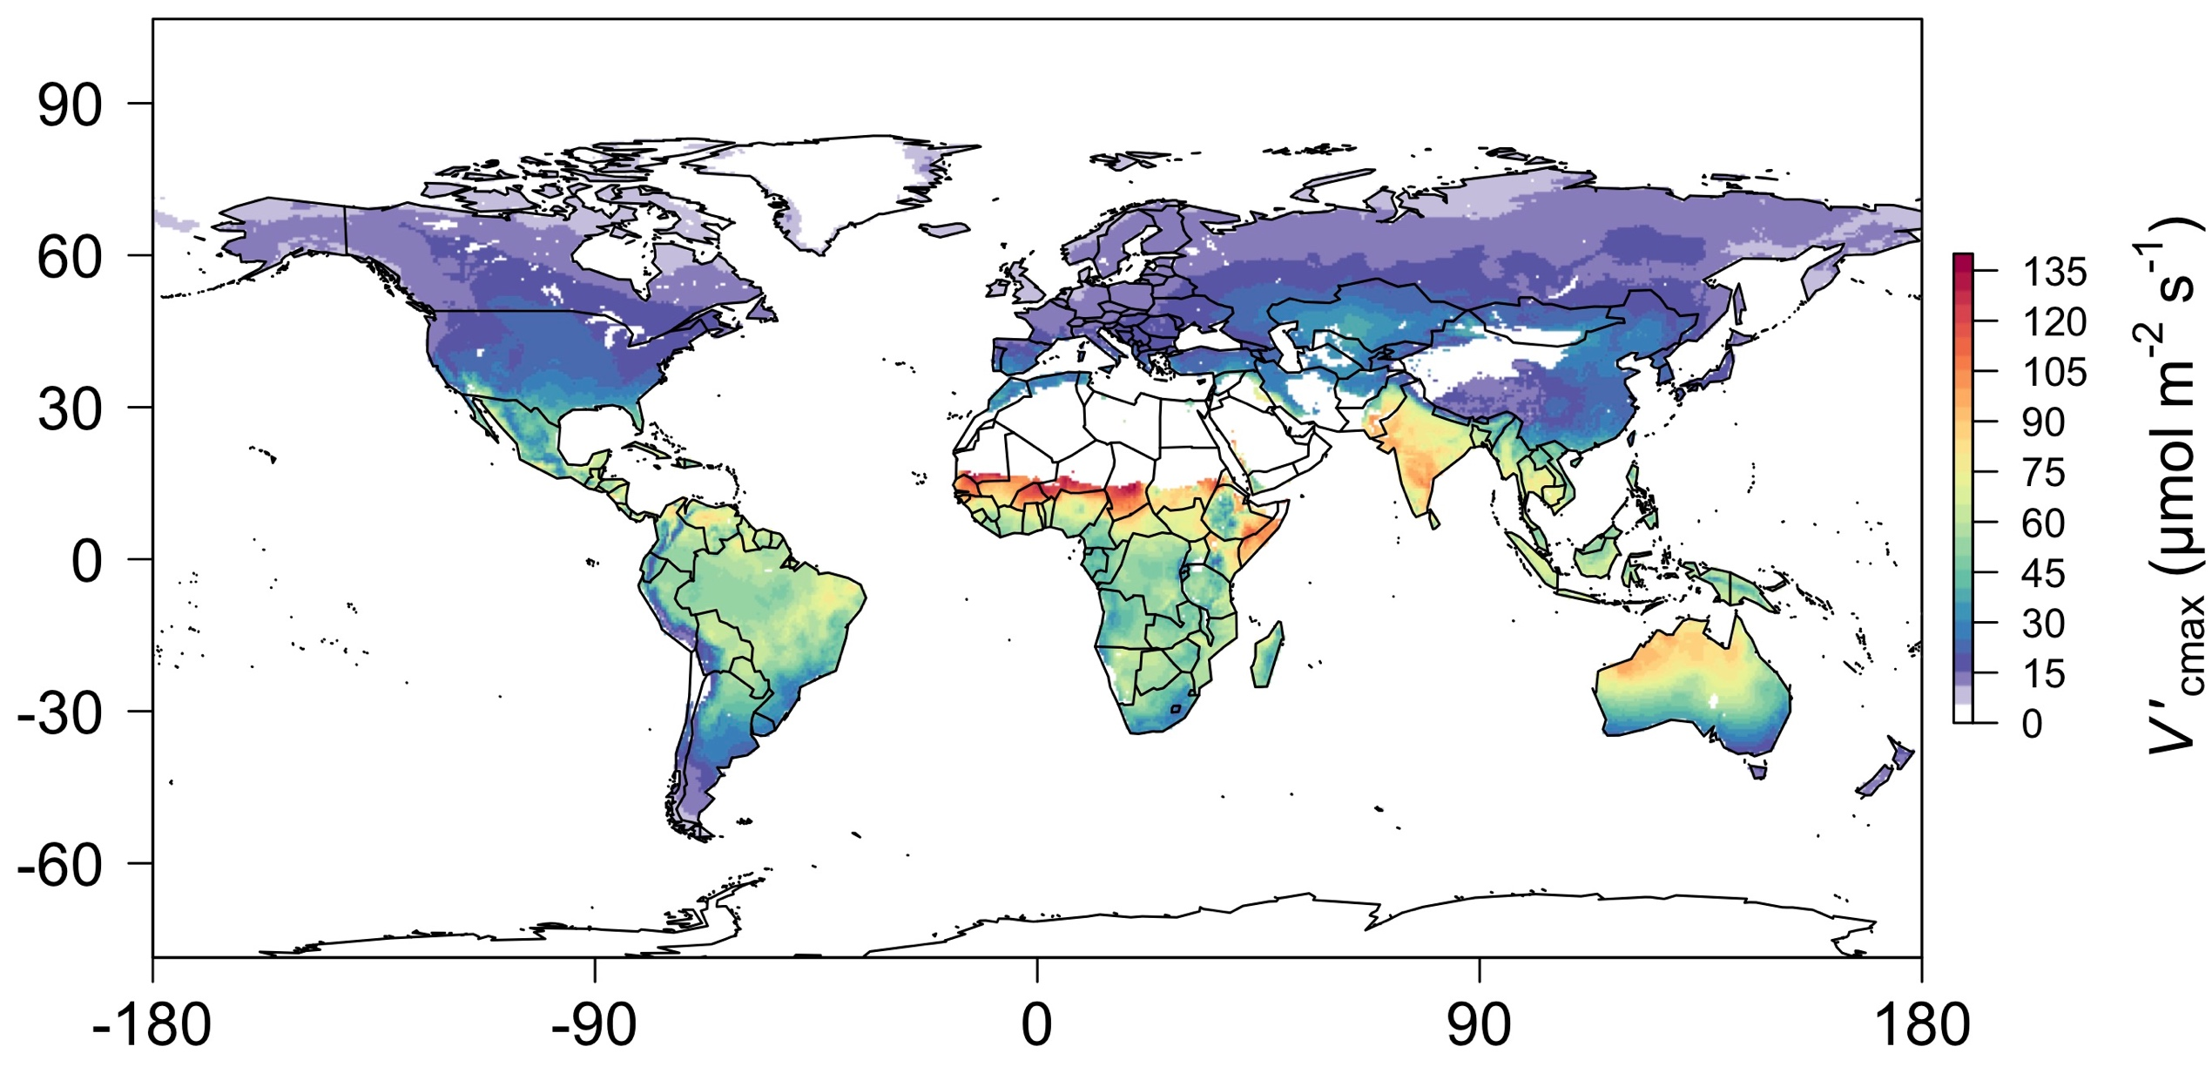
nick.smith@ttu.edu
Global, optimally acclimated traits!
Smith et al. (2019)

Slide 23
Important note: least-cost optimality model adds no free parameters to Farquhar et al. (1980) and Von Caemmerer (2000) models and dynamically predicts most
nick.smith@ttu.edu

Slide 24
Important note: adds acclimation, while reducing parametric uncertainty
nick.smith@ttu.edu

Slide 25

Let’s run a model out into the future!
nick.smith@ttu.edu

Slide 26
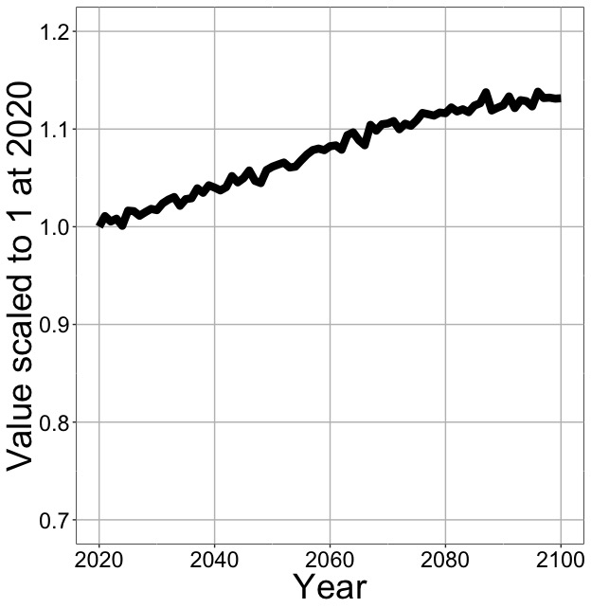
Photosynthesis increases in future
nick.smith@ttu.edu
Net Photosynthesis
Smith et al. (in prep)

Slide 27
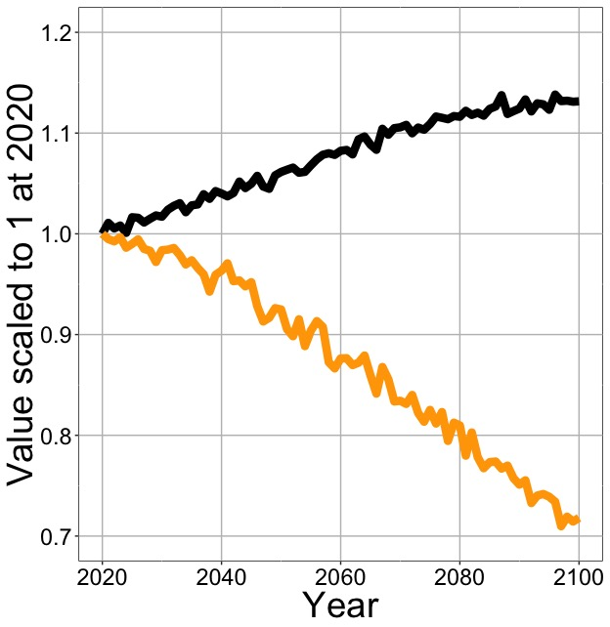
Photosynthesis increases in future (at lower nutrient use)
nick.smith@ttu.edu
Net Photosynthesis
Leaf Nitrogen
Smith et al. (in prep)

Slide 28
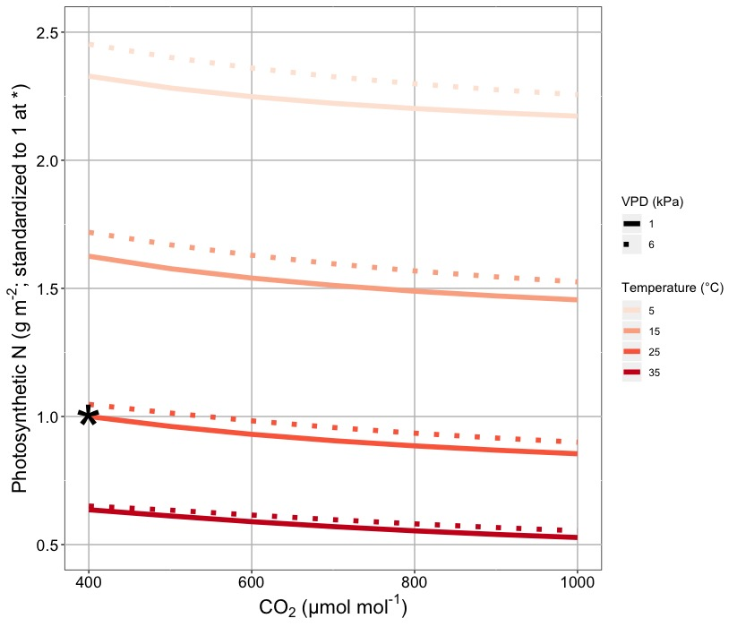
Leaf N declines due to warming and eCO₂
nick.smith@ttu.edu
Smith & Keenan (in review)

Slide 29
Photosynthesis increases in future (at lower nutrient use)
nick.smith@ttu.edu
Net Photosynthesis
Leaf Nitrogen
Smith et al. (in prep)

Slide 30
Photosynthesis increases in future (at lower nutrient use)
nick.smith@ttu.edu
Net Photosynthesis
Base ELM shows <5% change in leaf N
Leaf Nitrogen
Smith et al. (in prep)

Slide 31
What does this all mean and is it real?
nick.smith@ttu.edu

Slide 32
A typical LSM photosynthesis scheme
nick.smith@ttu.edu
Climate
Soil N
Leaf N
Photosynthesis

Slide 33
Least cost optimality model
nick.smith@ttu.edu
Climate
Photosynthesis

Slide 34
Let’s check this assumption
nick.smith@ttu.edu
Climate
Soil N
Leaf N
Photosynthesis

Slide 35
Does leaf N respond to soil N?
nick.smith@ttu.edu
Each box is proportional to the variance in leaf N explained by each variable
Smith et al. (in prep)

Slide 36
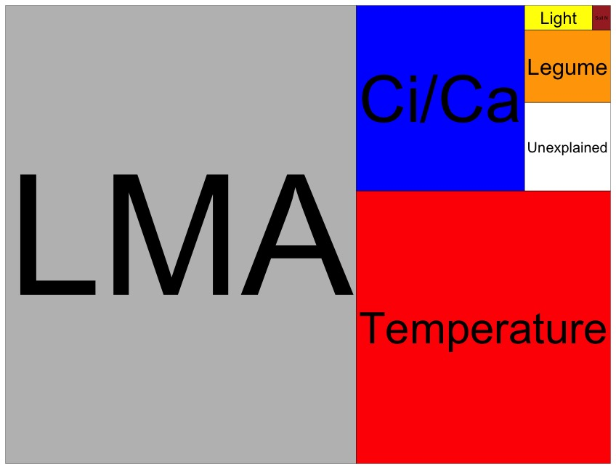
Globally, N addition little impact on leaf N
nick.smith@ttu.edu
Each box is proportional to the variance in leaf N explained by each variable
Smith et al. (in prep)

Slide 37
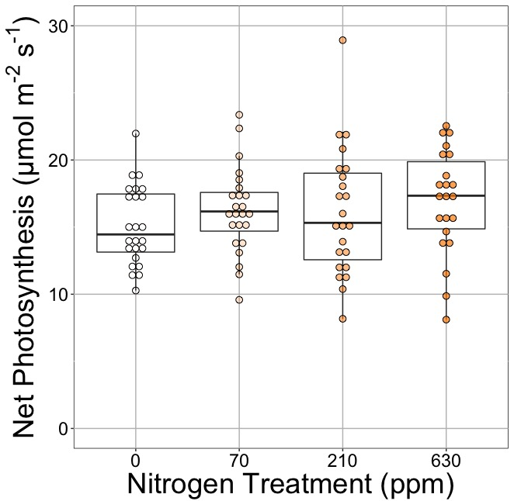
Does photosynthesis respond to soil N?
nick.smith@ttu.edu
Waring and Smith (in prep)

Slide 38
Photosynthesis does not change with soil N
nick.smith@ttu.edu
No change (P = 0.42)
Waring and Smith (in prep)

Slide 39
How does the optimality model do?
nick.smith@ttu.edu
Climate
Photosynthesis

Slide 40

nick.smith@ttu.edu
Optimal V_{cmax} is similar to observed values
Smith et al. (2019)

Slide 41
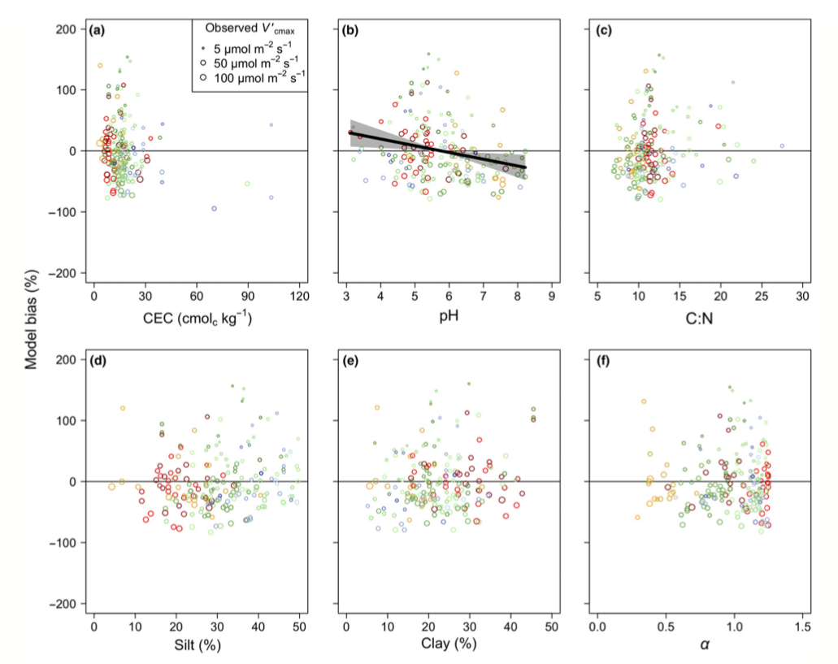
There is little effect of soils on V_{cmax}
nick.smith@ttu.edu
Soil increased explained variation from 64% to 68% compared to optimal response alone
Smith et al. (2019)

Slide 42
Does it work under future conditions?
nick.smith@ttu.edu

Slide 43
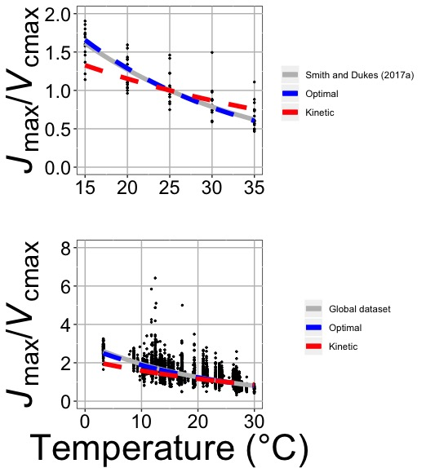
Photosynthetic traits change with temperature in ways expected from optimization
nick.smith@ttu.edu
Data = -0.051 °C⁻¹
Predicted = -0.048 °C⁻¹
Smith and Keenan (in review)

Slide 44
Photosynthetic traits change with future conditions in ways expected from optimization
nick.smith@ttu.edu
mean: -12%
mean: -15%
(P > 0.05)
Smith and Keenan (in review)

Slide 45
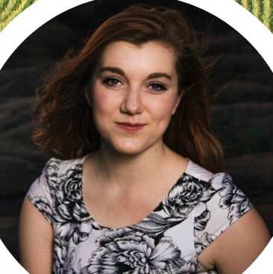
We now have an acclimation model for C₃ and C₄ species!
nick.smith@ttu.edu
Helen Scott
TTU

Slide 46
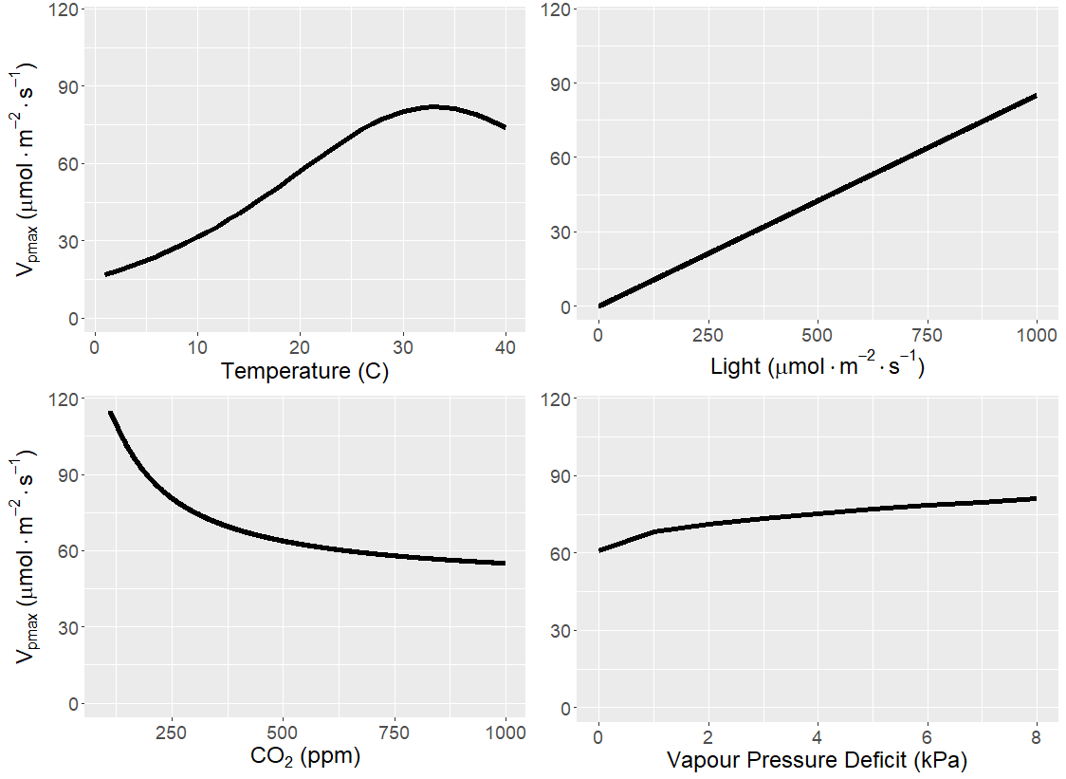
Photosynthetic biochemistry responds similarly in C₄ leaves as C₃ leaves
nick.smith@ttu.edu
Scott and Smith (in prep)

Slide 47
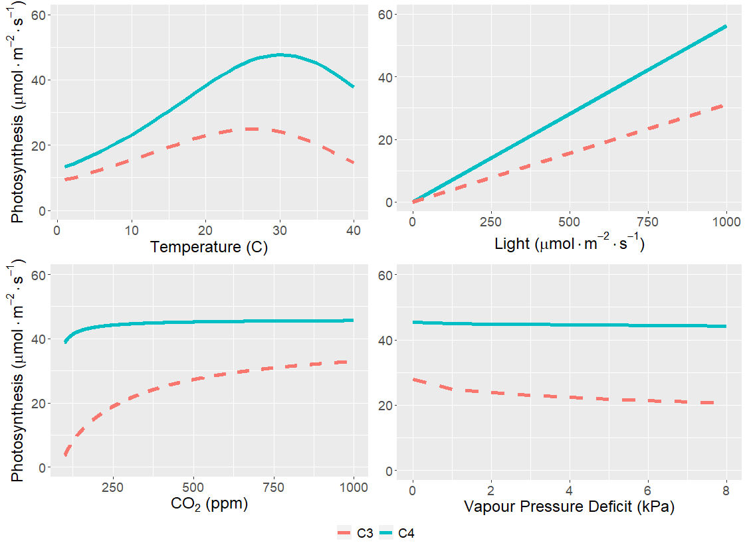
As expected, C₄ species are most benefitted under hot, dry, low CO₂ conditions
nick.smith@ttu.edu
Scott and Smith (in prep)

Slide 48
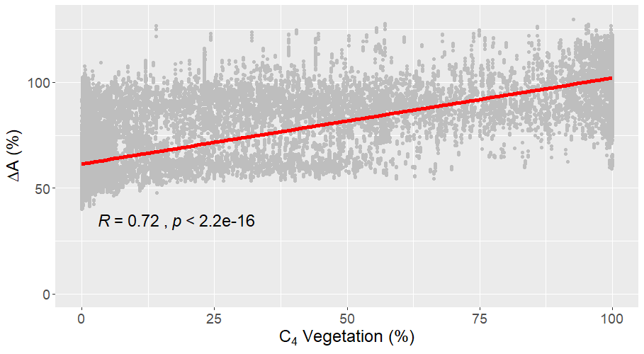
This correlates with C₄ cover
nick.smith@ttu.edu
Scott and Smith (in prep)

Slide 49
Some takeaways
nick.smith@ttu.edu

Slide 50
Some takeaways
nick.smith@ttu.edu
Optimal leaf biochemical setup is determined by climate

Slide 51
Some takeaways
nick.smith@ttu.edu
Optimal leaf biochemical setup is determined by climate
Plants mine for nutrients to get the most leaves at the optimal setup

Slide 52
Some takeaways
nick.smith@ttu.edu
Optimal leaf biochemical setup is determined by climate
Plants mine for nutrients to get the most leaves at the optimal setup
Photosynthetic demand determines leaf nutrients, not the other way around

Slide 53
nick.smith@ttu.edu
Axes need flipped
Kattge et al. (2009)

Slide 54
Some takeaways
nick.smith@ttu.edu
Optimal leaf biochemical setup is determined by climate
Plants mine for N to get the most leaves at the optimal setup
Photosynthetic demand determines leaf N, not the other way around
Soil nutrient availability determines biomass investment

Slide 55
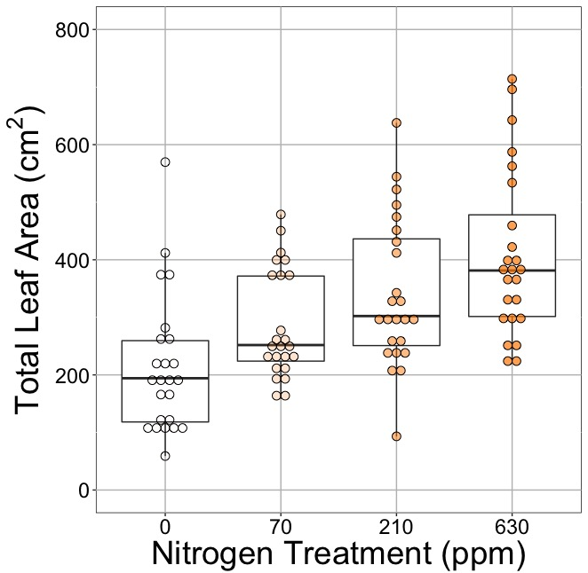
nick.smith@ttu.edu
No change (P = 0.42)
91% increase (P < 0.05)
Waring and Smith (in prep)

Slide 56
Some takeaways
nick.smith@ttu.edu
Optimal leaf biochemical setup is determined by climate
Plants mine for N to get the most leaves at the optimal setup
Photosynthetic demand determines leaf N, not the other way around
Soil N determines biomass investment
Future conditions may provide relatively greater benefits to C₃ over C₄ species

Slide 57
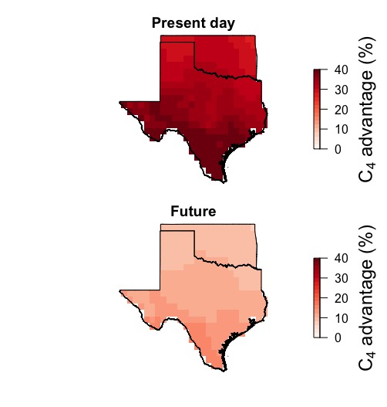
nick.smith@ttu.edu
Scott and Smith (in prep)

Slide 58
FATES implementation
nick.smith@ttu.edu

Slide 59
FATES implementation – Code changes
nick.smith@ttu.edu
No new parameters beyond Farquhar et al. (1980; C3) and Von Caemmerer (2000; C4)
Will need running mean environmental conditions
More tractable code?

Slide 60
FATES implementation – Code changes
nick.smith@ttu.edu
New scheme
Predict acclimated “basal rate” each time step using mean conditions
Apply scalars to calculate photosynthesis at a given timestep (as already in model)
Calculate leaf nutrient demand (reverse current leaf nutrient equations)
Use available nutrients to build optimal leaves
Leaf stoichiometry will vary with acclimation (i.e., leaf demand)
Allocate any “saved” nutrients to new tissues
Model may already do optimal nutrient allocation?

Slide 61
FATES implementation – Trait variability
nick.smith@ttu.edu
Variation would come from aboveground environmental variation
Need variation in environment the leaves are experiencing
Spatial → variability across gridcells with climate variability
Spatial → within gridcell would need to arise by changes in environment
Temporal → within and across season variability as conditions change

Slide 62
FATES implementation – “Tweakable” parameters
nick.smith@ttu.edu
Quantum efficiency of photosystem II
Including its temperature response
Acclimation ”timescale”
Acclimation “to what”?
Average conditions
Maximum conditions

Slide 63
FATES implementation – Cool science questions
nick.smith@ttu.edu
C₃/C₄ competition
Allocation responses*
Nutrient feedbacks (whole plant and ecosystem)*
Timescale of acclimation*
Acclimation “to what”*
*Could be “strategy”-specific!

Slide 64
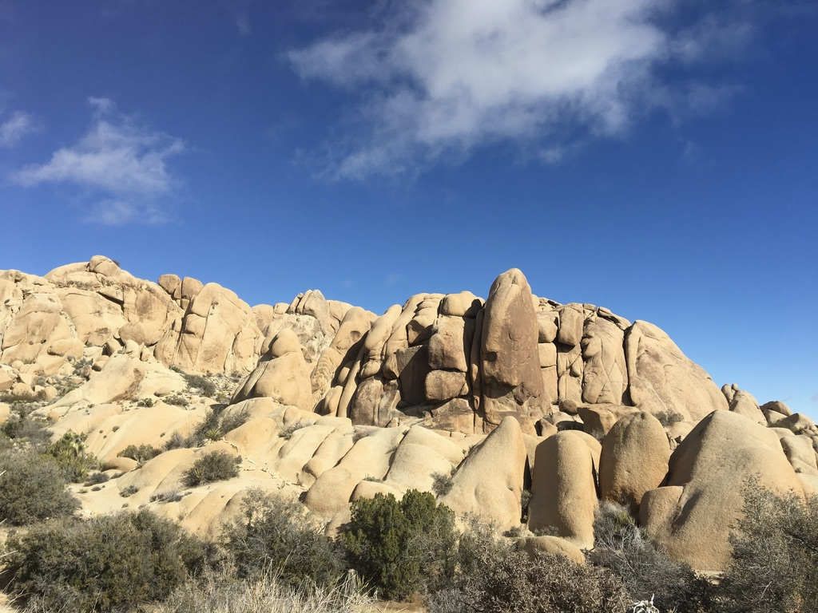
nick.smith@ttu.edu
Presentation available at:
www.github.com/SmithEcophysLab/seminar/2020_fates
Thanks!

